Slide 1
AI/ML Inventory Detection
Recording inventory automatically for historical analysis
Kevin Tran
Solutions Architect
kevintptran@gmail.com

Slide 2
Table of Contents
Overview
Storyboard
Demo
Future State
Conclusion

Slide 3
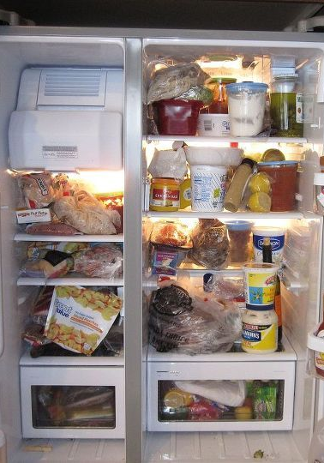
Background
What food is in my refrigerator?
Want a way to automatically detect what is in their storage & view historical trends of inventory over time
Use historical trends to conduct inventory analysis

Slide 4
Project Overview
Objective and Key Results (OKRs)
Provide a platform to automatically record down inventory for countable items (fruits).
Provide an interface to view the historical trends.
Key Performance Indicators (KPIs)
Record inventory stock within seconds.
Provide a web platform to view historical data entries.

Slide 5
Storyboard

Slide 6




Recording Inventory Data
Users authenticate through the web platform & generate a snapshot of the inventory.
The snapshot asset is saved in Amazon S3 storage.
The snapshot is processed and detects the count of unique items using Amazon Rekognition.
The count of objects and image location is recorded into Amazon Timestream.

Slide 7

Viewing Historical Inventory
Users authenticate through the web platform & view the inventory.
Historical inventory with timestamps is retrieved from storage.
Clicking on any point retrieves the associated image and data entry from Amazon S3

Slide 8
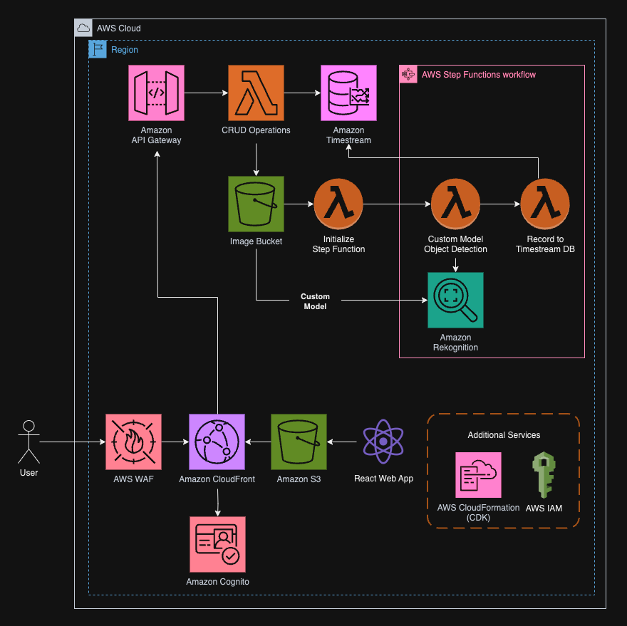
Architecture Diagram

Slide 9
Demo

Slide 10
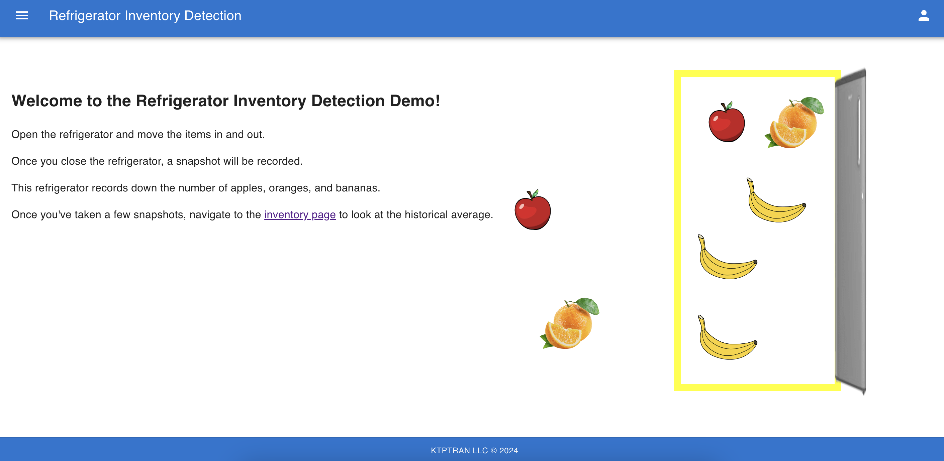
Recording Inventory
After logging into the system, open the refrigerator and move around the fruits. Once you close the fridge, a snapshot will be saved and analyzed to record.

Slide 11
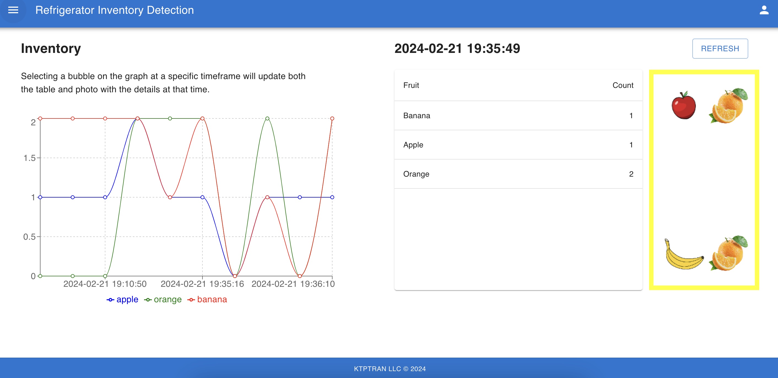
Inventory Historical View
With a few entries, navigate to the inventory page through the sidebar. Here you can view the inventory at any specific time and retrieve its associated image.

Slide 12
Future State

Slide 13
Project Timeline
Sprint 1
(2/13-2/23)
Sprint 2
(2/26-3/8)
Sprint 3
(3/11-3/22)
Web interface security
Point-in-time retrieval of historical snapshot
Project assets
Web interface platform
User authentication
Snapshot workflow
Amazon Rekognition Model training
Inventory count workflow
Historical view page

Slide 14
Platform Expenses
Web Hosting Platform
AWS WAF
Amazon CloudFront
Amazon S3
Backend Processing
Amazon Cognito
Amazon API Gateway
Amazon Rekognition
AWS Lambda
Amazon Timestream
User Data
Inventory detection model data
Snapshot image asset storage
Inventory record storage

Slide 15
Additional Features
Amazon Rekognition Model accuracy: scaling images to tens of thousands
IoT Ingestion: Utilizing IoT devices such as cameras to generate snapshots of real-life inventory
AI/ML Inventory Prediction: Using Amazon Forecast to forecast predictions of inventory to prevent cases of not having items in inventory.

Slide 16
Kevin Tran
Solutions Architect
kevintptran@gmail.com
https://www.linkedin.com/in/ktptran/

Slide 17
Appendix
Example Case Study: https://aws.amazon.com/blogs/machine-learning/build-an-automatic-inventory-solution-using-public-datasets-with-amazon-rekognition-custom-labels/
Community Showcase Blog: https://aws.amazon.com/blogs/machine-learning/amazon-rekognition-custom-labels-community-showcase/

